Slide 1
THICK FACE BLACK HEART “Kalın – Siyah” kuramı bağlamında “İŞ HAYATINDA SÜRDÜRÜLEBİLİR BAŞARI” eğitimi

Slide 2
THICK FACE BLACK HEART
The Warrior Philosophy for Conquering the Challenges of Business and Life

Slide 3
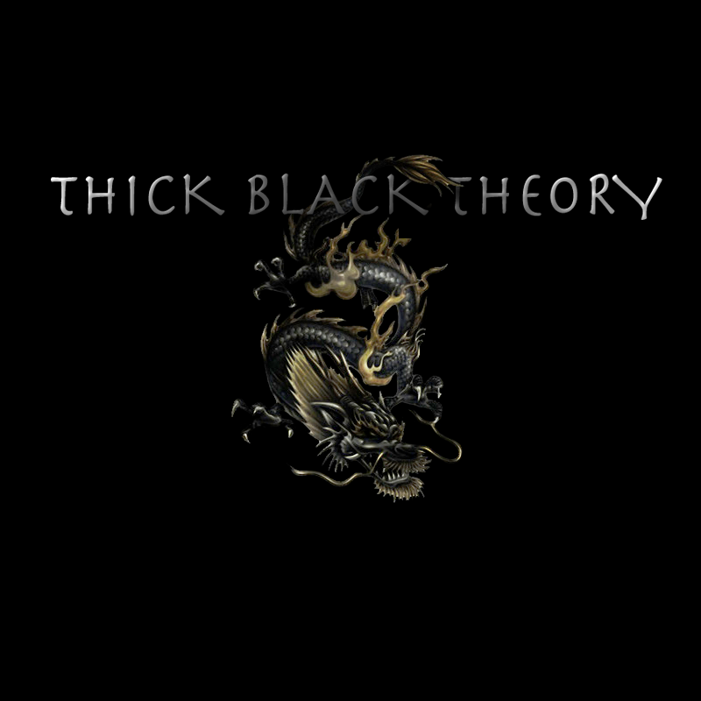
Dr. M. Tuğrul KIRMIZI - MARSHAN

Slide 4
WHAT IS “ SUSTAINABLE SUCCESS AND HAPPINESS IN LIFE AND BUSINESS ?
Sustainable happiness takes into account that happiness is interconnected with other people, other species, and the natural environment by a remarkable web of interdependence.
http://www.yesmagazine.org/happiness/sustainable-happiness-6-ways-to-get-there
1. Cultivate Appreciation
2. Embrace your Natural Highs
3. Chart Your Sustainable Happiness Footprint
4. Create an Interdependence Map
5. Make Your Own "Happy List“
HAYATTA VE İŞ HAYATINDA “SÜRDÜRÜLEBİLİR BAŞARI VE MUTLULUK” NEDİR ?

Slide 5
WHAT IS THE “BASIC HARDWARE” THAT IS REQUIRED FOR “HAPPINESS” AND “SUCCESS” ?
BAŞARI VE MUTLULUK İÇİN GEREKEN “TEMEL DONANIM” NASIL TANIMLANABİLİR?

Slide 6
CAN WE REACH SOME CLUES BY ANALYSING
“SUCCESSFUL EXAMPLES TO UNDERSTAND STRATEGIES APPLIED ON THOSE ?
“BAŞARILI” OLARAK VERİLEBİLECEK ÖRNEKLER ÜZERİNDE YAPILAN ANALİZLER BU ÖRNEKLERDE UYGULANMIŞ BENZER STRATEJİLER KONUSUNDA BİZE İP UÇLARI VEREBİLİR Mİ?

Slide 7
?
“SUCCESS & HAPPINESS” - CAN WE DEFINE AN END STATE SITUATION FOR “SUCCESS & HAPPINESS”
“BAŞARI VE MUTLULUK” “SONLANDIRILMIŞ – END STATE” BİR DURUM MUDUR
“

Slide 8
SUSTAINABLE SUCCESS & HAPPINESS SÜRDÜRÜLEBİLİR BAŞARI VE MUTLULUK
“HAPPINESS & SUCCESS” - JOURNEY OF A LIFETIME.
MUTLULUK VE BAŞARI ÖMÜR BOYU SÜRECEK BİR YOLCULUKTUR. BİR VARIŞ NOKTASI DEĞİLDİR

Slide 9
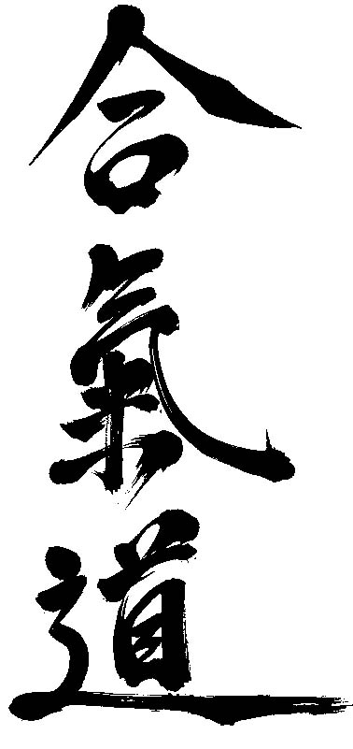
SI VIS PACEM
PARA BELLUM

Slide 10
INTRODUCTION TO “SYSTEMS THINKING”
“SİSTEM DÜŞÜNCESİ” KAVRAMLAŞMALARINA GİRİŞ.
WHAT IS PHILOSOPHY ?
FELSEFE NEDİR?
“NEGOTIATIONS” THEORY
MÜZAKERE KURAMI

Slide 11
WARRIOR PHILOSOPHY *** BEFORE NEGOTIATION AND AFTER NEGOTIATON
SAVAŞÇI FELSEFESİ MÜZAKEREDE VE SONRASINDA NASIL BİR İŞLEV KAZANIR ?
“CONTRACTS” THEORY
MUKAVELE KURAMI

Slide 12
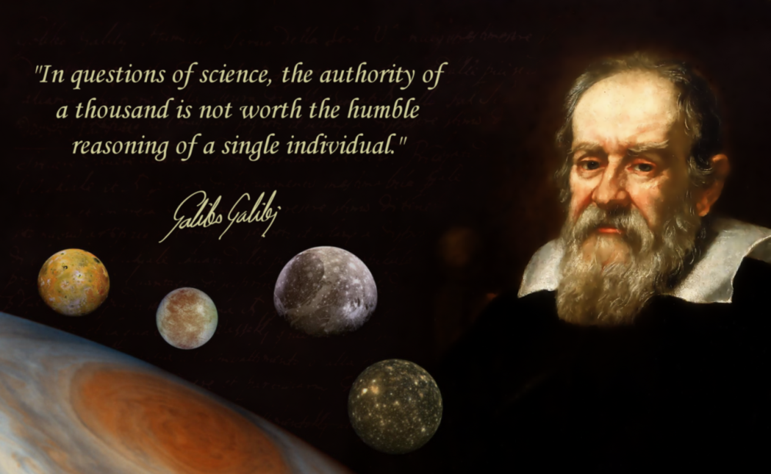
SOCRATES VS GALILEO
SOCRATES
GALILEO

Slide 13
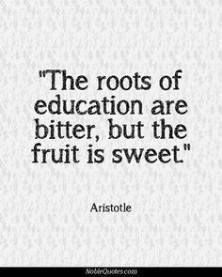
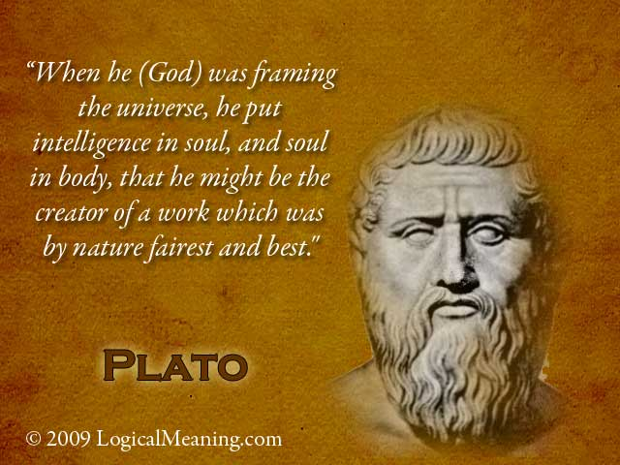
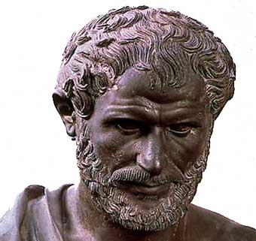
ARISTOTELES
PLATO

Slide 14
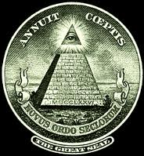
WARRIOR PHILOSOPHY SAVAŞÇI FELSEFESİ

Slide 15
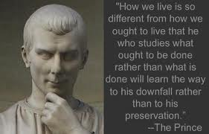
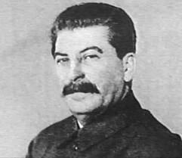
ALL IS FARE IN LOVE AND WAR ??? SAVAŞÇI FELSEFEDE BAŞARIYA GÖTÜREN HER YOL MÜBAH GÖRÜLEBİLİR Mİ ?
MACHIAVELLI
STALIN

Slide 16
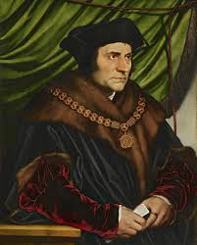
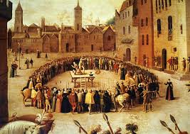
ONE MISSING SIGNATURE *** The Sword and Shield for People *** TEK BİR EKSİK İMZA BÜTÜN BİR SOSYAL MUKAVELEYİ GEÇERSİZ KILAR MI?
THOMAS MORE “A MAN FOR ALL SEASONS”

Slide 17
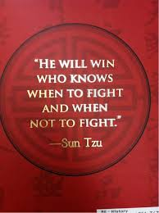
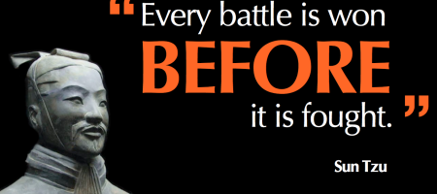
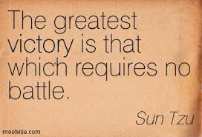
WARRIOR PHILOSOPHY

Slide 18
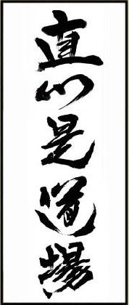
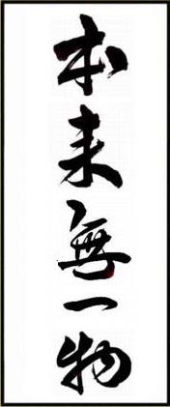
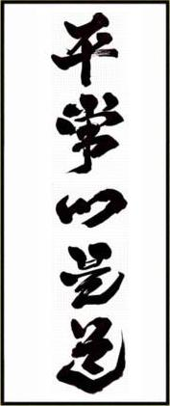
ZEN PHILOSOPHY
DOJO
NOTHING
?
CONSTANT MIND

Slide 19
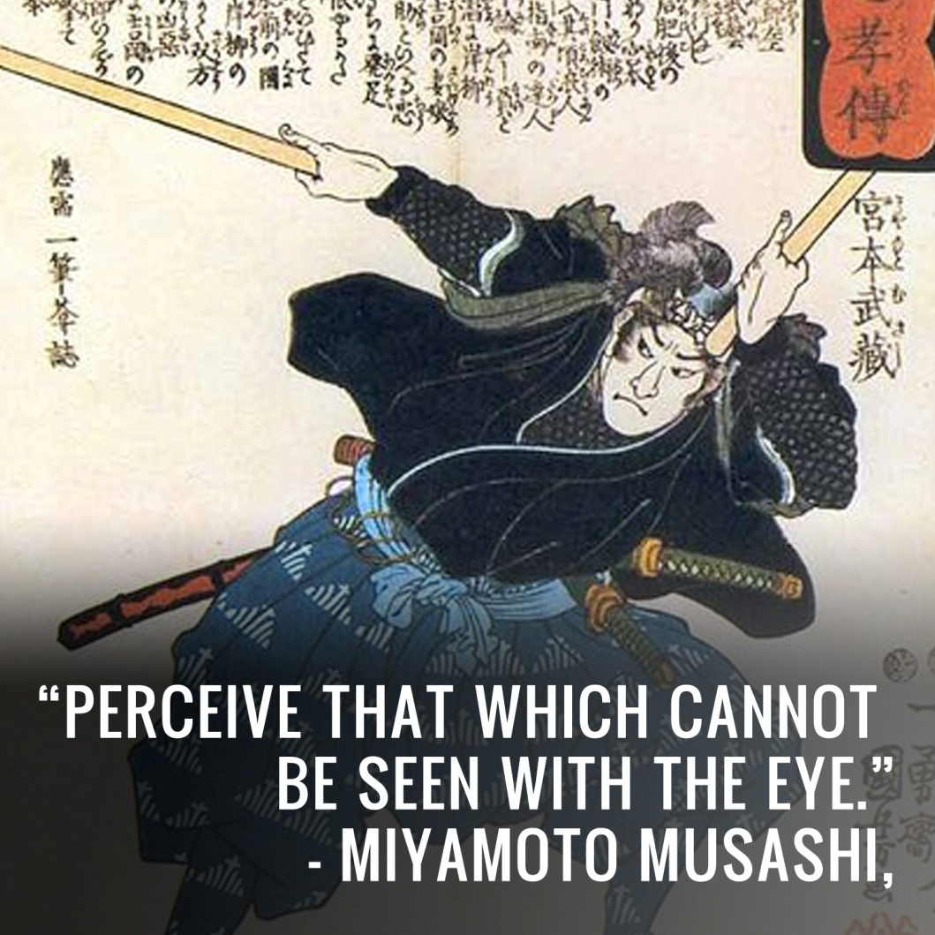
WARRIOR PHILOSOPHY

Slide 20
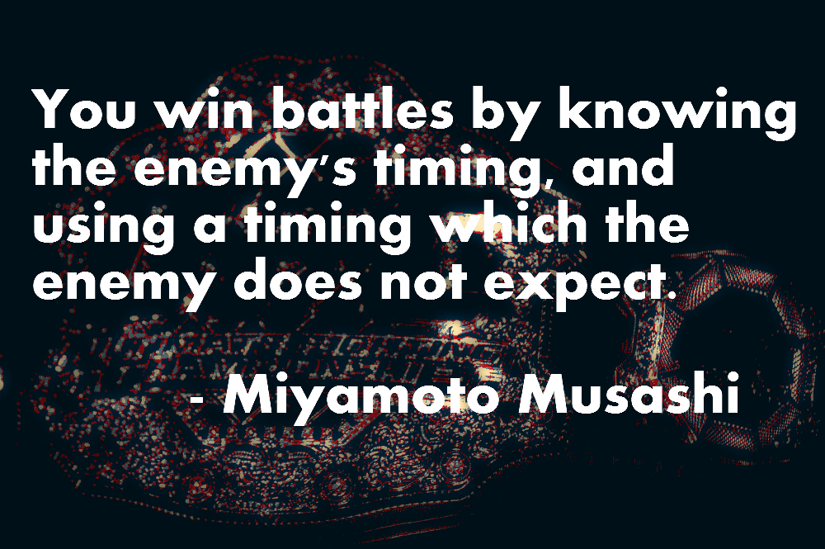
THICK BLACK THEORY

Slide 21
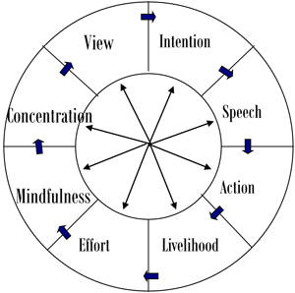
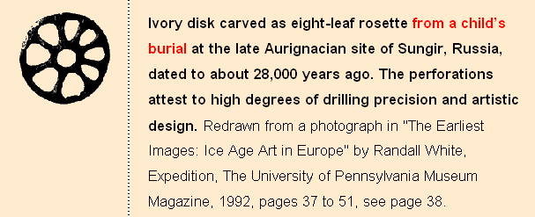
WHAT IS DHARMA ?

Slide 22
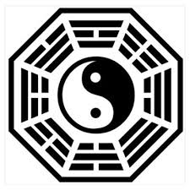
WHAT IS DHARMA?

Slide 23
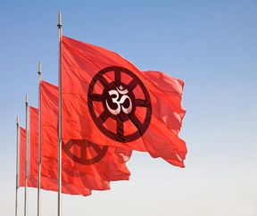
WHAT IS DHARMA ?

Slide 24
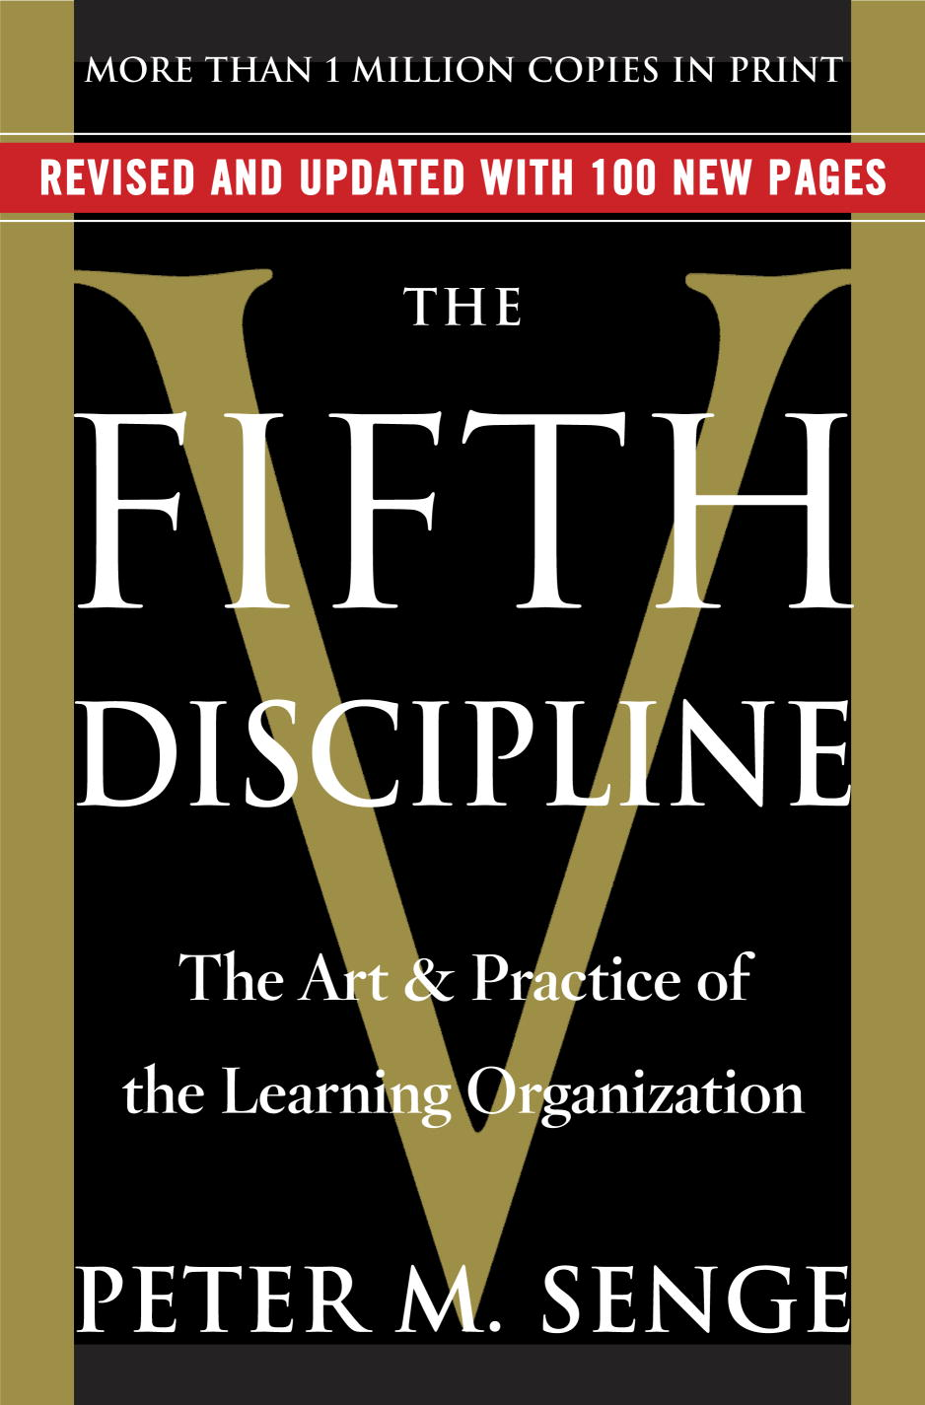

Slide 25
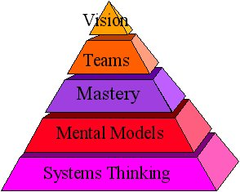
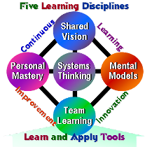
FIFTH DISCIPLINE

Slide 26
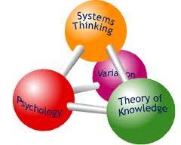
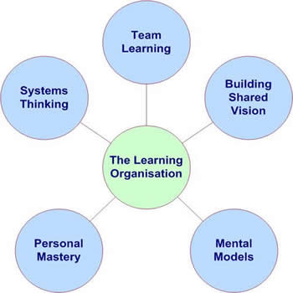
FIFTH DISCIPLINE

Slide 27
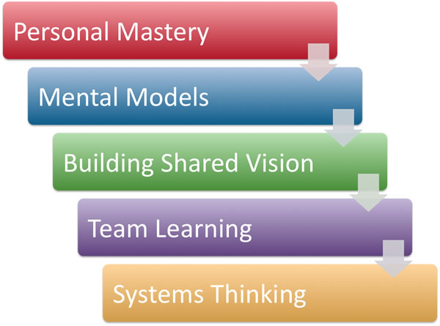
FIFTH DISCIPLINE

Slide 28
FIFTH DISCIPLINE

Slide 29
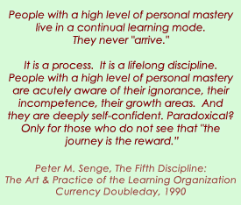

Slide 30
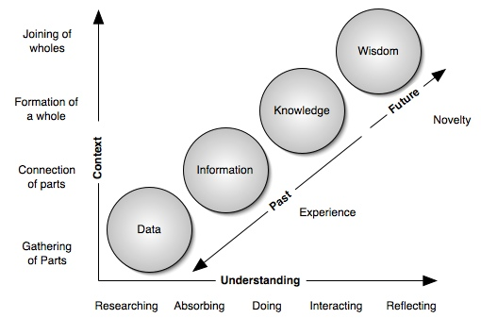

Slide 31
The Enneagram of Personality, or simply the Enneagram (from the Greek words ἐννέα [ennea, meaning "nine"] and γράμμα [gramma, meaning something "written" or "drawn"^{[1]}]), is a model of human personality which is principally understood and taught as a typology of nine interconnected personality types. Although the origins and history of many of the ideas and theories associated with the Enneagram of Personality are a matter of dispute, contemporary Enneagram understandings are principally derived from the teachings of Oscar Ichazo and Claudio Naranjo. Naranjo's theories were partly influenced by some earlier teachings of G. I. Gurdjieff. As a typology the Enneagram defines nine personality types (sometimes referred to as "enneatypes"), which are represented by the points of a geometric figure called an enneagram,^{[2]} which, it is believed, also indicate some of the connections between the types. There are different schools of thought among Enneagram teachers, therefore their ideas on some theoretical aspects are not always in agreement.^{[2]}
The Enneagram of Personality has been widely promoted in both business management and spiritual contexts through seminars, conferences, books, magazines, and DVDs.^{[3][4]} In business contexts it is generally used as a typology to gain insights into workplace dynamics; in spirituality it is more commonly presented as a path to higher states of being, essence, and enlightenment. It has been described as a method for self-understanding and self-development.^{[3]}
The Enneagram has been criticized as being pseudoscience and subject to interpretation, making it difficult to test or validate scientifically^{[5]} and as "an assessment method of no demonstrated reliability or validity".^{[6]} The skeptic Robert Todd Carroll has characterized the Enneagram as an example of a pseudoscientific theory that "can't be tested because they are so vague and malleable that anything relevant can be shoehorned to fit the theory".^{[7]}

Slide 32
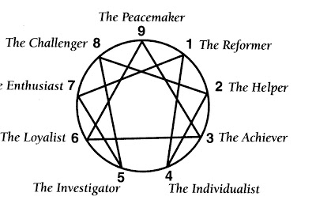

Slide 33
